Slide 1
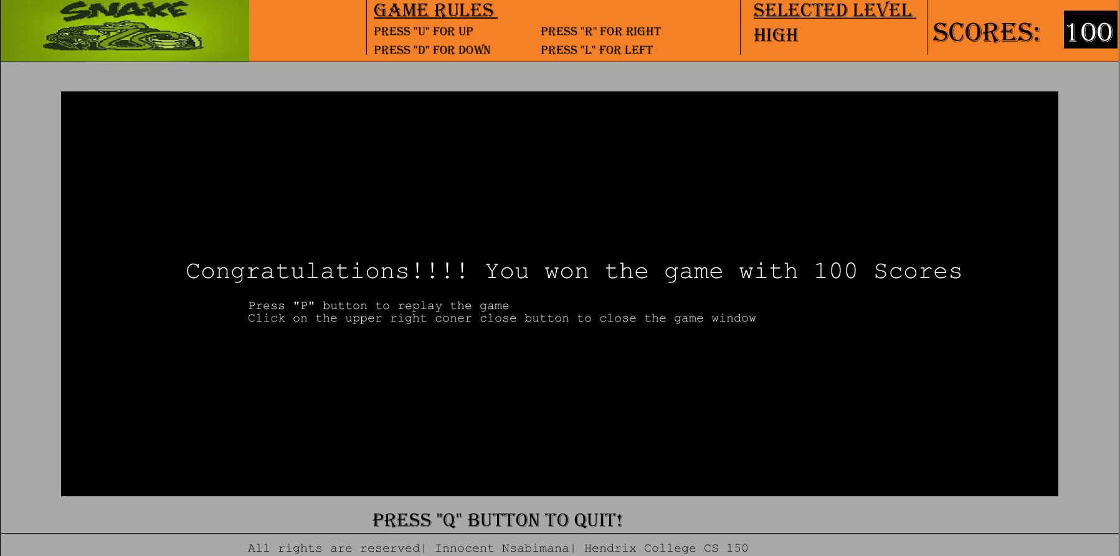
Computer Science 150
Final Project
Level selection
Scoring part
Loosing & winning

Slide 2
Design
- Snake object
- Snake_cells object
- Interface object

Slide 3
Design Implementation
Moving snake stage
Colliding the boundary and eating food
Making a graphical user interface better

